Slide 1
DATA 55100– Unsupervised Machine Learning
Dr. Sam Abuomar
DATA 55100– Unsupervised Machine Learning
Post-Clustering Analysis Dr. Sam Abuomar
Dept. of Engineering, Computing, and Mathematical Sciences

Slide 2

Introduction to Cluster Validity
Number of clusters (C) is not known a priori
However, we specify C (or a hidden variant!) for a clustering algorithm (e.g. FCM, PCM, etc.)
Already discussed that there are many ways to
produce different types and numbers of clusters
e.g. via different distance measures
What constitutes a good clustering?
Depends on an experts perception of “goodness”
Today we will focus on compact and well-separated

Slide 3
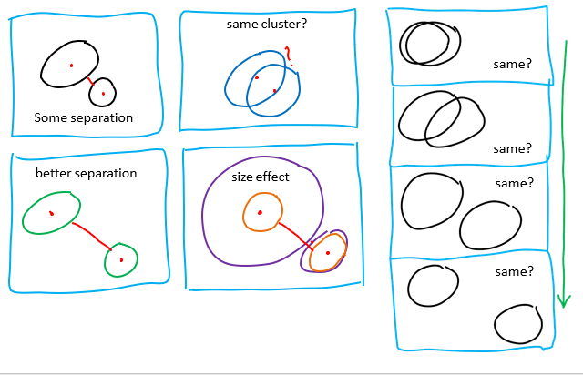

Slide 4
Cluster validity indices
Choose best U in CP
Picking from a candidate partition set (CP)
Index is computed at each U in CP, v(U)
Values are used to evaluate the best U in CP (U*)
U* optimizes v over CP (max or min)
U* is the antecedent or successor partition that essentially optimizes the derivative of v (often referred to as the “big jump” approach)

Slide 5
Cluster validity indices
Almost all optimization and big jump indices are
internal criteria
i.e., they use only internal information that is generated by
the clustering process itself to select U*
The second group of methods use comparison indices, s(U,V), that compare pairs of partitions
If U and V are both in CP (and hence, both obtained by algorithmic means), s(U,V) is an internal criterion, and otherwise, we call it an external criterion.

Slide 6
Many indices exist!!!!
Bezdek’s partition coefficient
Dunn’s separation index
Xie-Beni’s separation index
Davies-Bouldin’s index
Gath-Geva index
etc.

Slide 7
Many indices exist!!!!
Bezdek’s partition coefficient
Dunn’s separation index
Xie-Beni’s separation index
Davies-Bouldin’s index
Gath-Geva index
etc.

Slide 8
What information do we look at?
Procedures that evaluate the clustering results in a quantitative and objective function
Different approaches exist
Some evaluate the properties of the crisp structure
imposed on the data by a clustering algorithm
Some, e.g. in the case of fuzzy clustering algorithms, use only the information of fuzzy membership grades to evaluate clustering results
Some make use of not only the fuzzy membership
grades, but also the structure of the data

Slide 9
Dunn’s index

Slide 10
Dunn’s index

Slide 11
Davies-Bouldin’s index

Slide 12

Partition coefficient

Slide 13
Classification entropy

Slide 14
Separation index

Slide 15
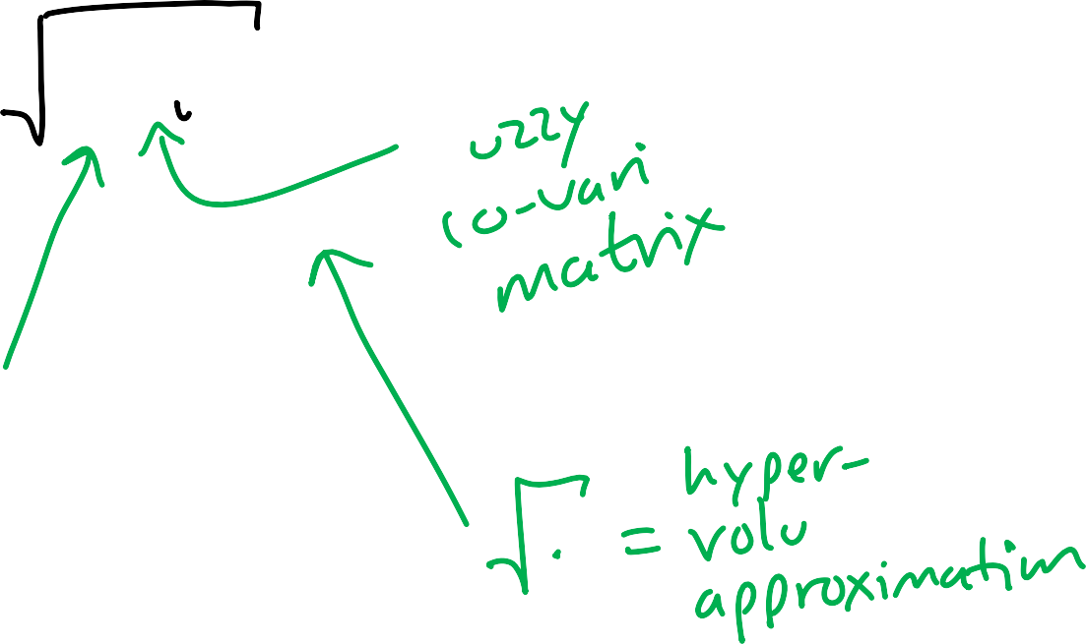
Fuzzy hypervolume

Slide 16
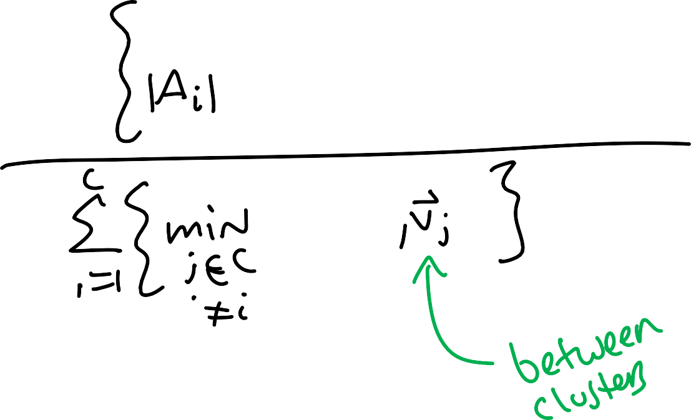
CS index

Slide 17
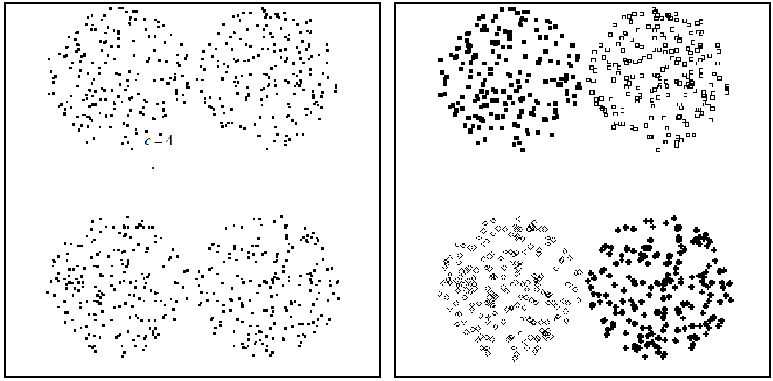
Four spherical clusters

Slide 18
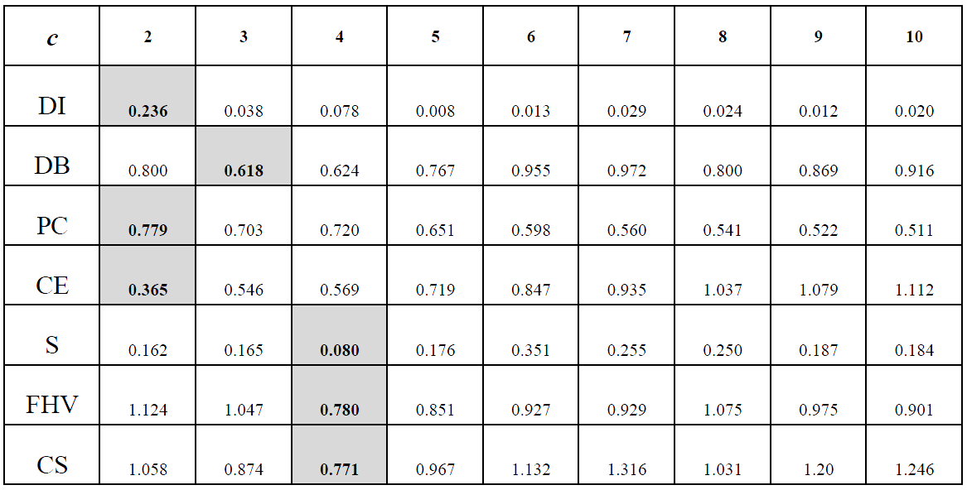
Four spherical clusters

Slide 19
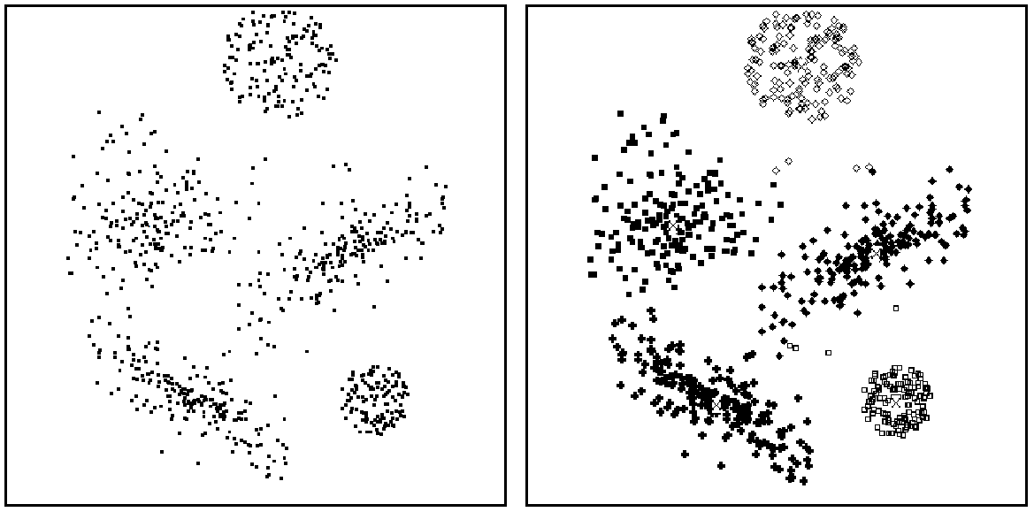
Mixture of spherical and ellipsoidal

Slide 20
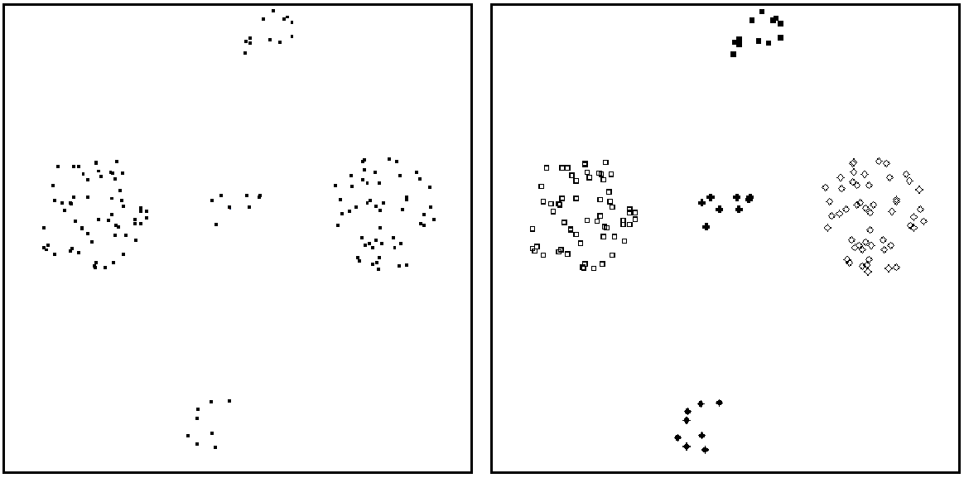
Five clusters

Slide 21
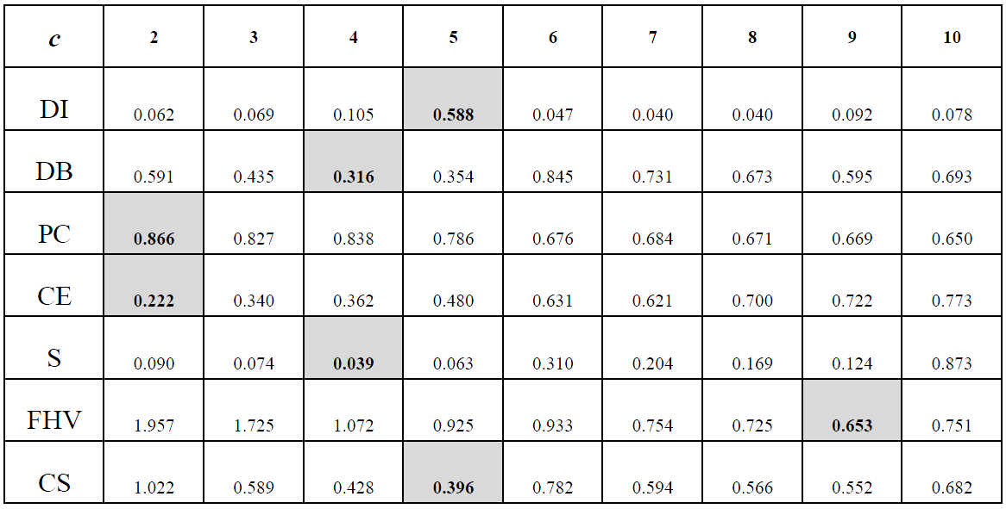
Five clusters

Slide 22
Which one is correct?

